Slide 1

Risky X Users Classification via Heterogeneous Graph Convolutional Network
Rocco Caliandro
Antonio Raffaele Iacovazzi
Big Data Exam Prof. Michelangelo Ceci

Slide 2

Introduction: The CRISP-DM Methodology

Slide 3
Business Understanding
In today’s globalized world, social networks play a crucial role in connecting individuals, allowing them to share personal updates and express opinions.
Users who show interest in risky content are increasingly exposed to similar content and related user increasing the risk of radicalization.
Correctly identifying the role of a user as safe or risky, in a social network, is not a trivial task.
Borderline users.
Silent users who engage in
«lurking» (not represented in
our dataset).

Slide 4

Business Understanding: The Role of X
X is one of the most used social network used for sharing political ideas, with around 335.7 million of users worldwide.
Used also by prominent political figures in order to influence society.

Slide 5
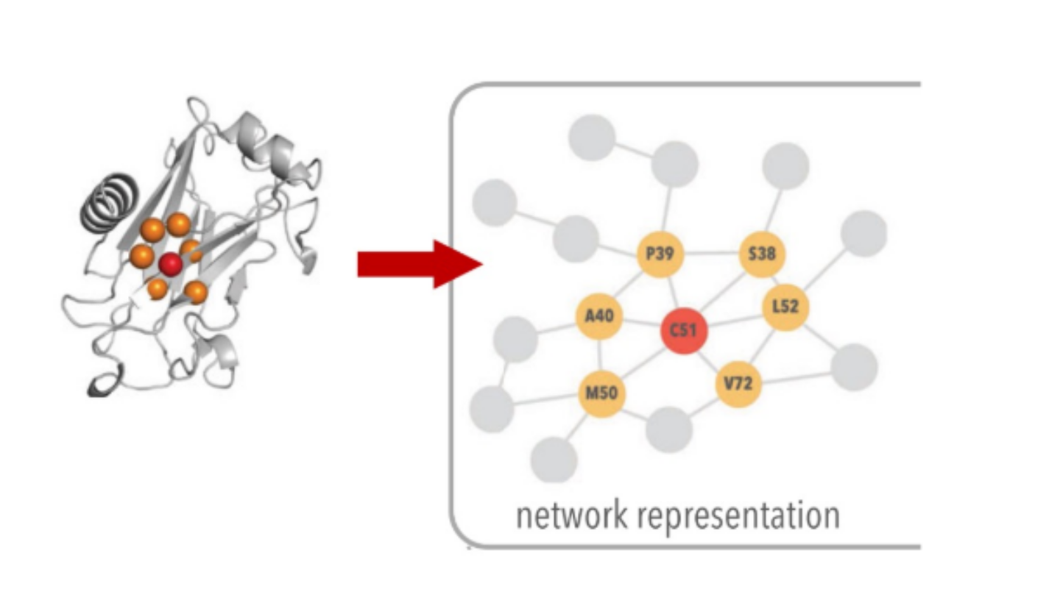
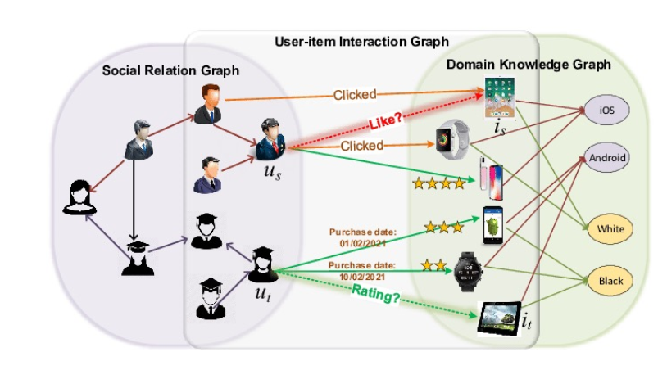
Business Understanding: Goal
Identify the user type (safe or risky) in a sample of X data by using GCNs (Graph Convolutional Networks). This should help to go beyond trivial content analisys.
GCNs are neural networks that operate on graph-structurated data learning a representation of each node that involve also information about it's neighbourhood.

Slide 6
Data Understanding
Graph dataset built sampling content from X presenting a total of 4701 users labeled as safe or risky.
2654 safe users and 2047 risky users (slightly imbalanced dataset).
The dataset presents two kind of relationship between node:
Social network by taking into account the "follows" relationship between users.
Spatial network by taking into account the geographical distance between users.
13078 connections in the social network.
More than 15 million connections in the spatial network.

Slide 7
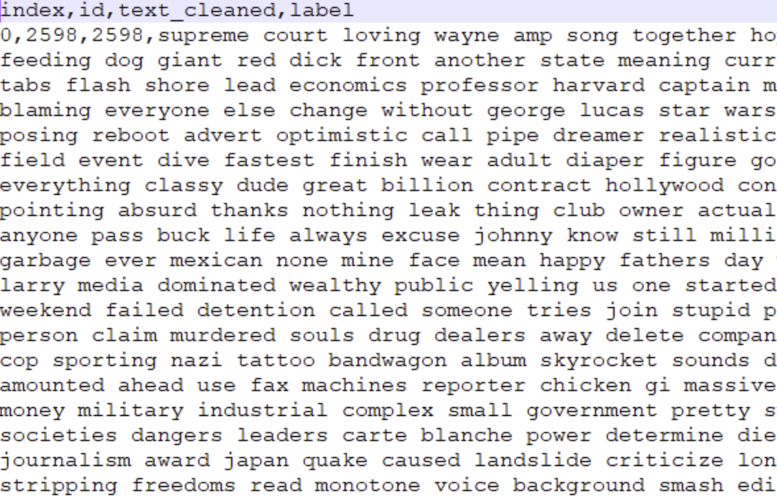
Data Understanding: Graph Structure
User nodes represented as the concatenation of all the textual content produced by the user, preprocessed by using the usual NLP pipeline, along with an id and their label (0: safe, 1: risky).

Slide 8
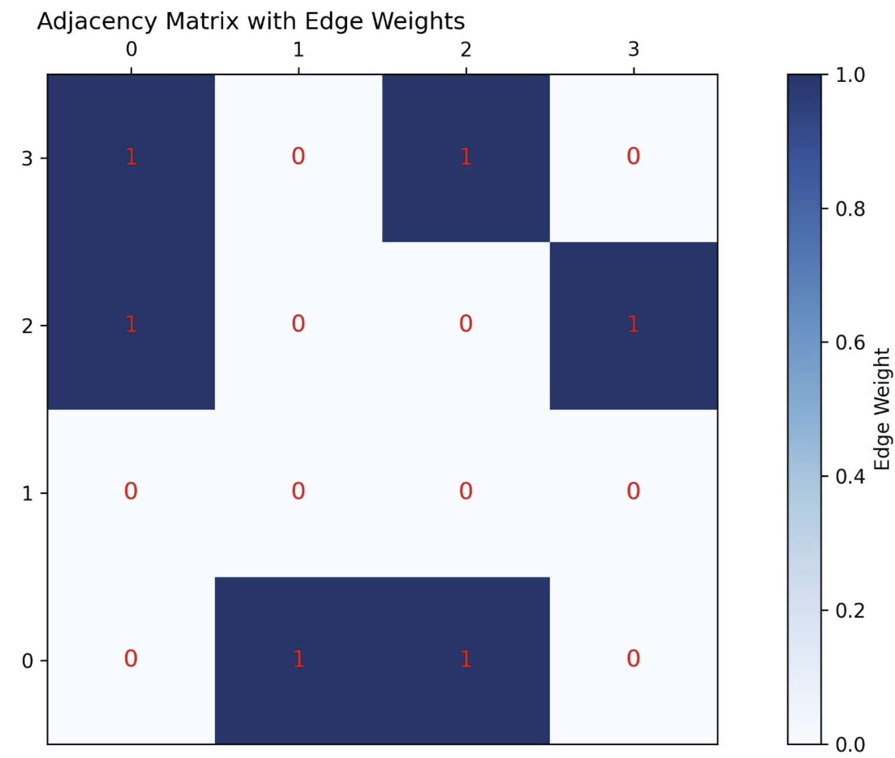
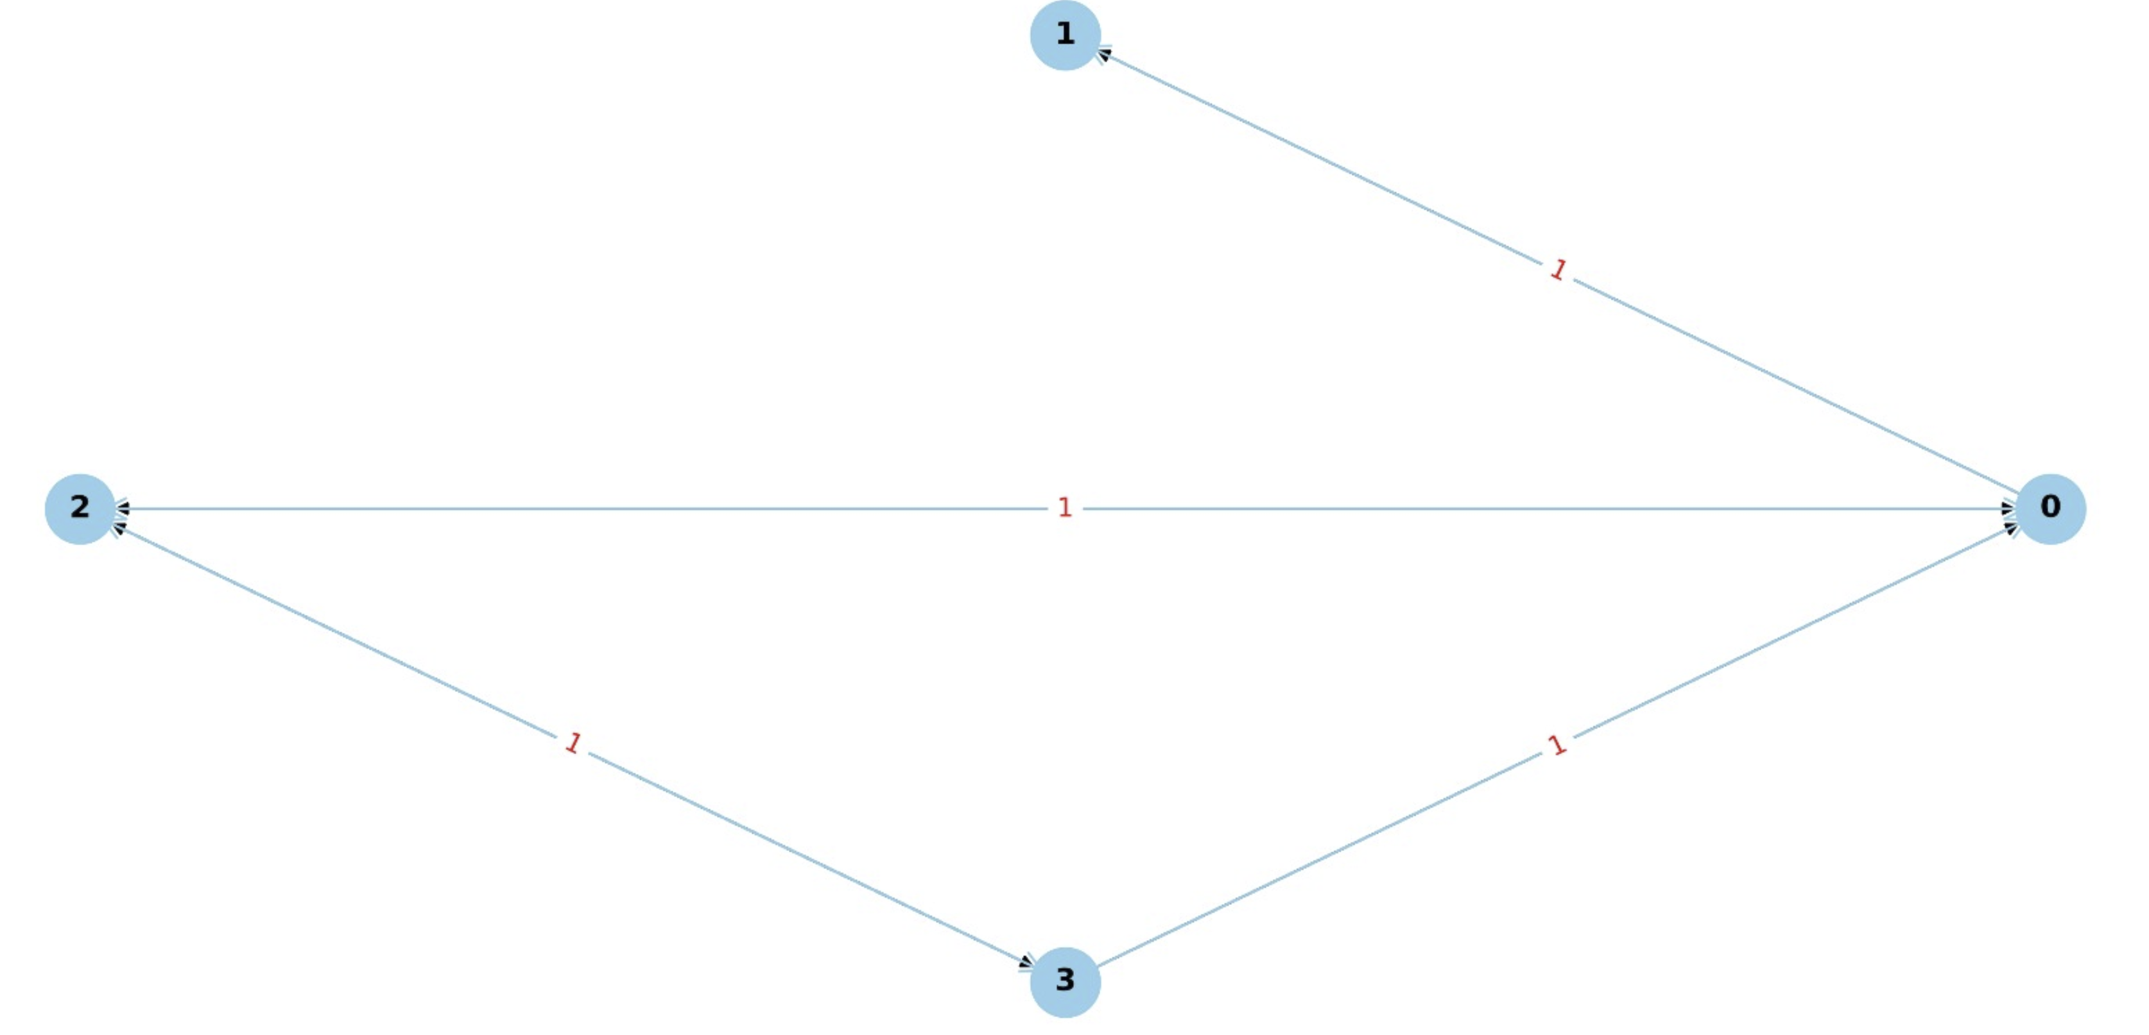
Data Understanding: Graph Structure
The social network forms a directed graph.

Slide 9
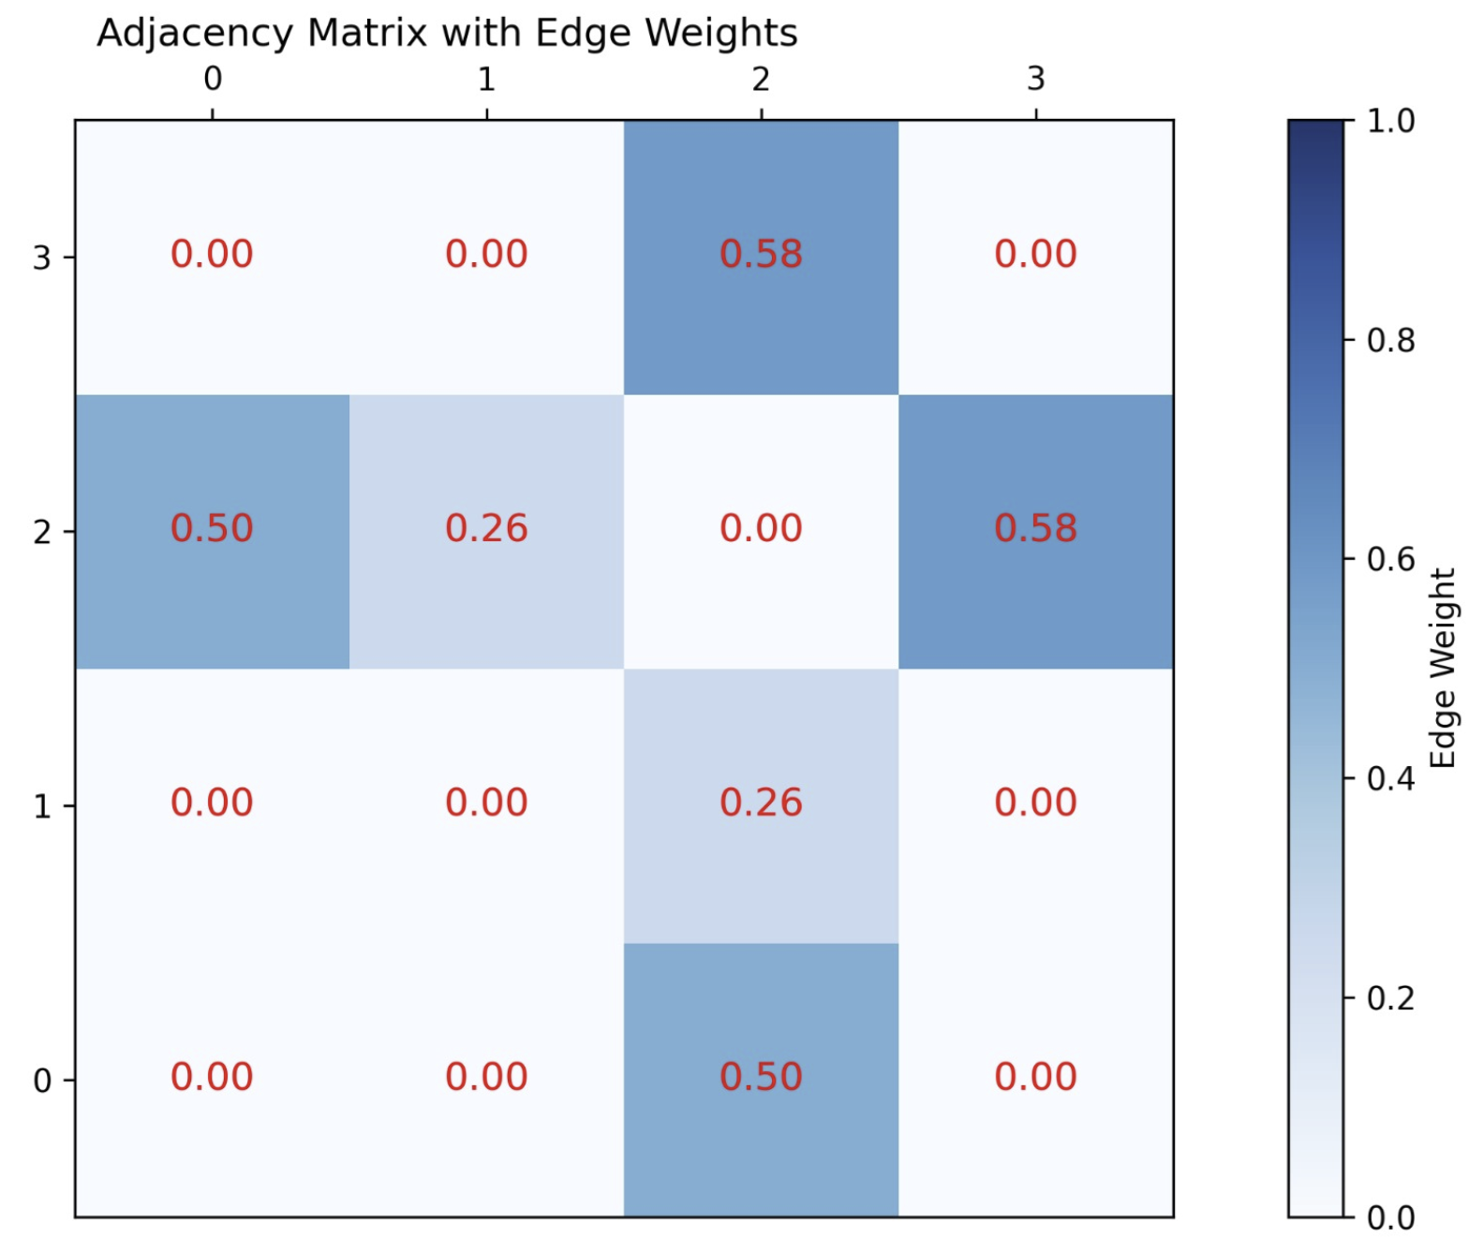
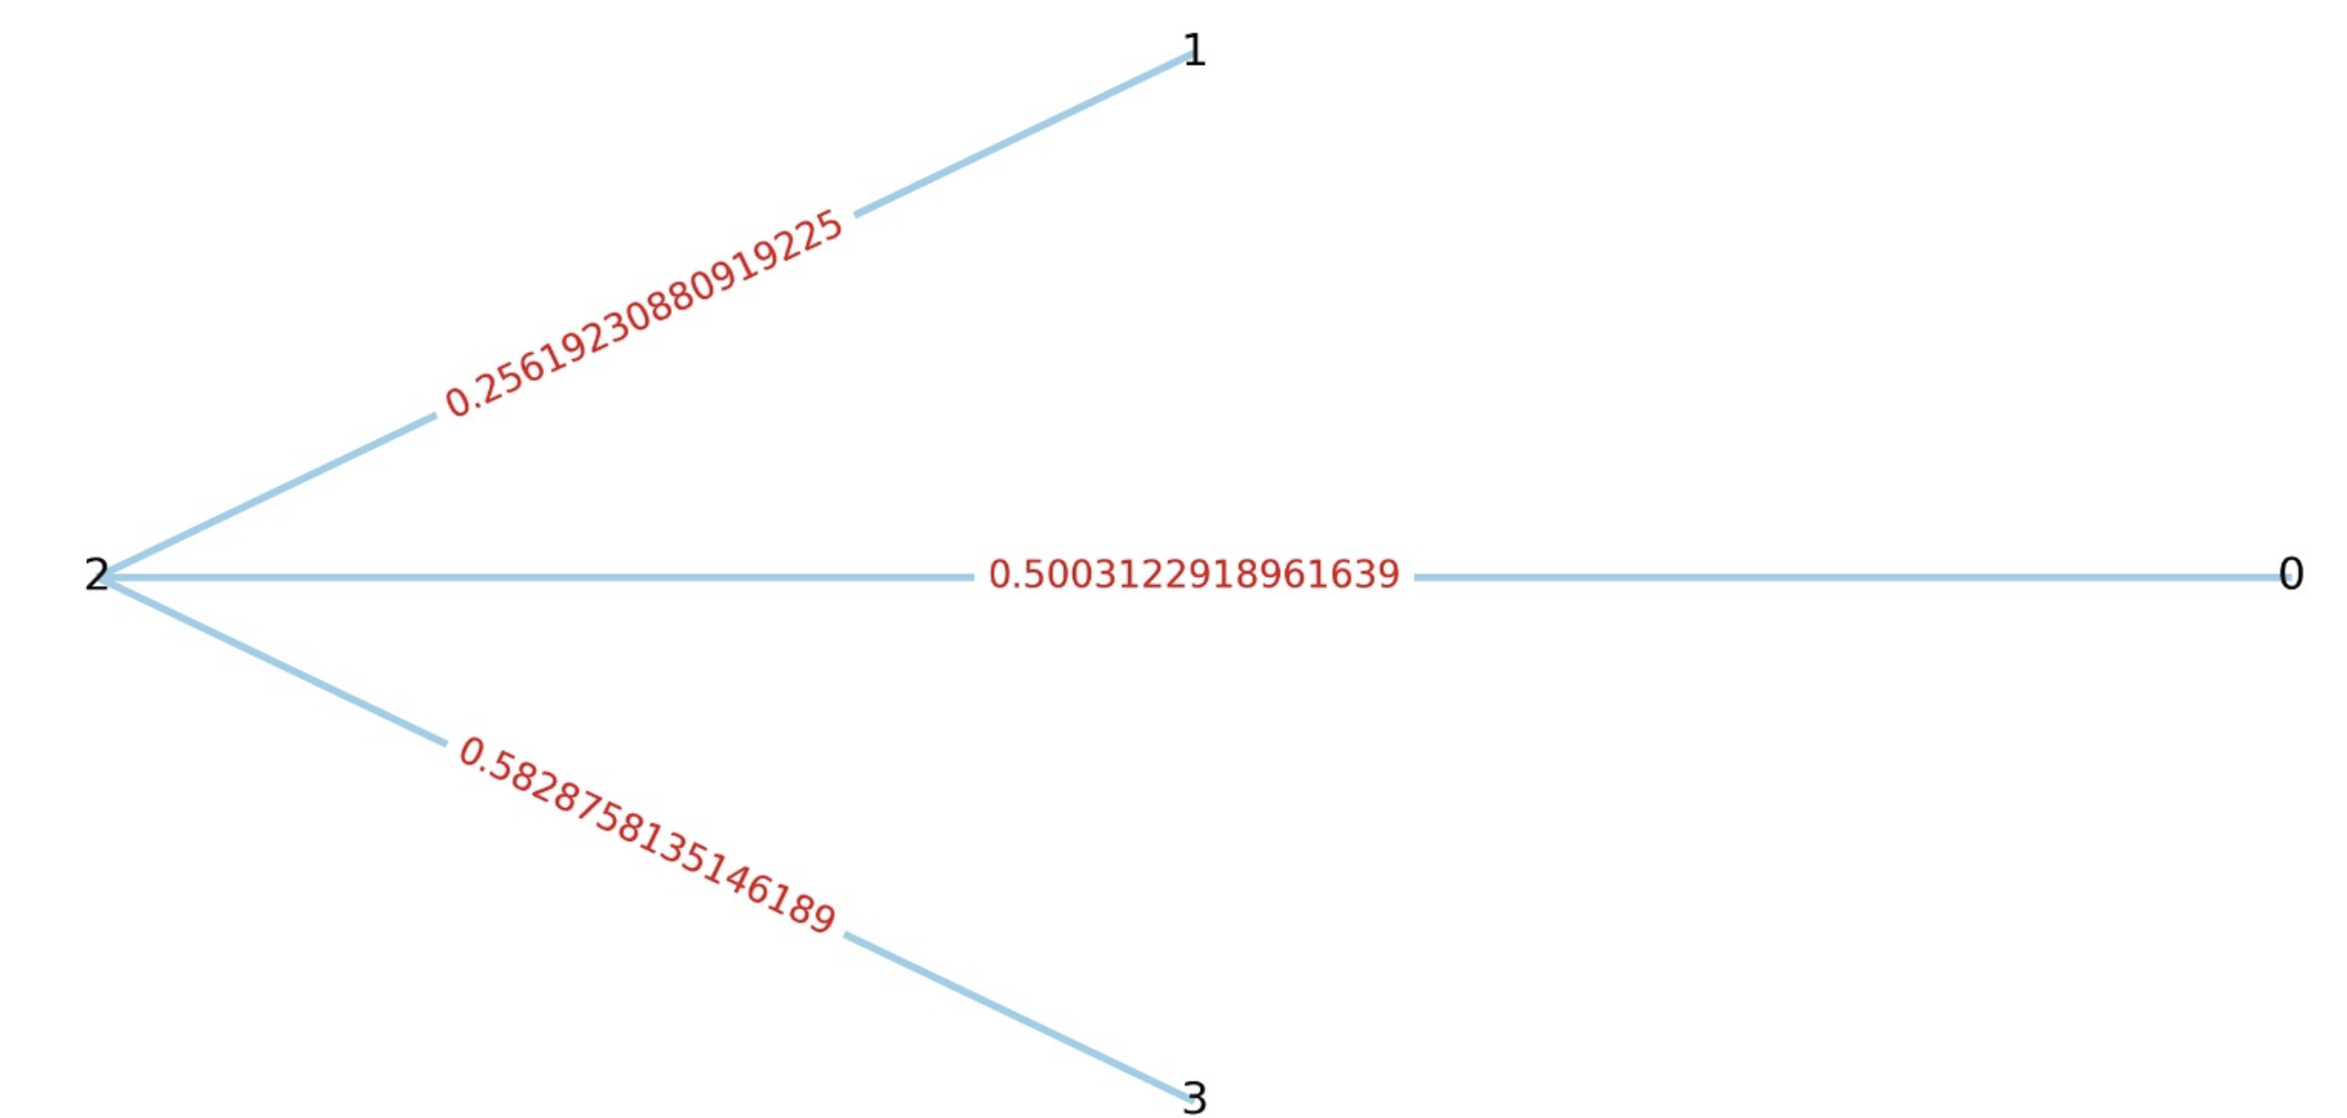
Data Understanding: Graph Structure
The spatial network forms an undirected weighted graph.

Slide 10
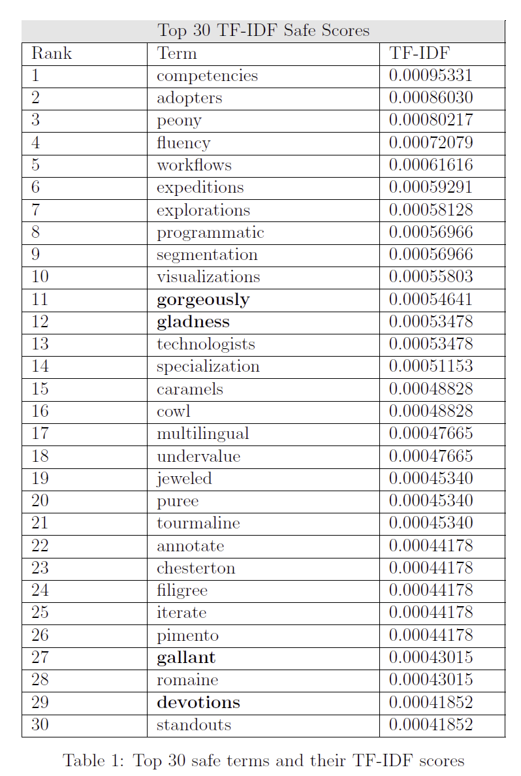
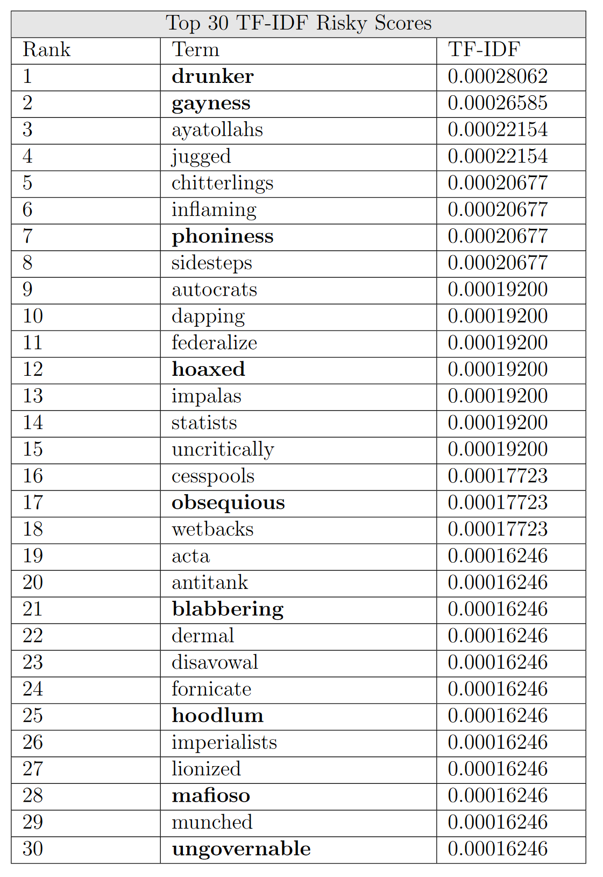
Data Understanding: Textual Analysis
We computed the TF-IDF scores on the exclusive terms of each class to gain insight on which textual features are significantly related to one class or the other.

Slide 11
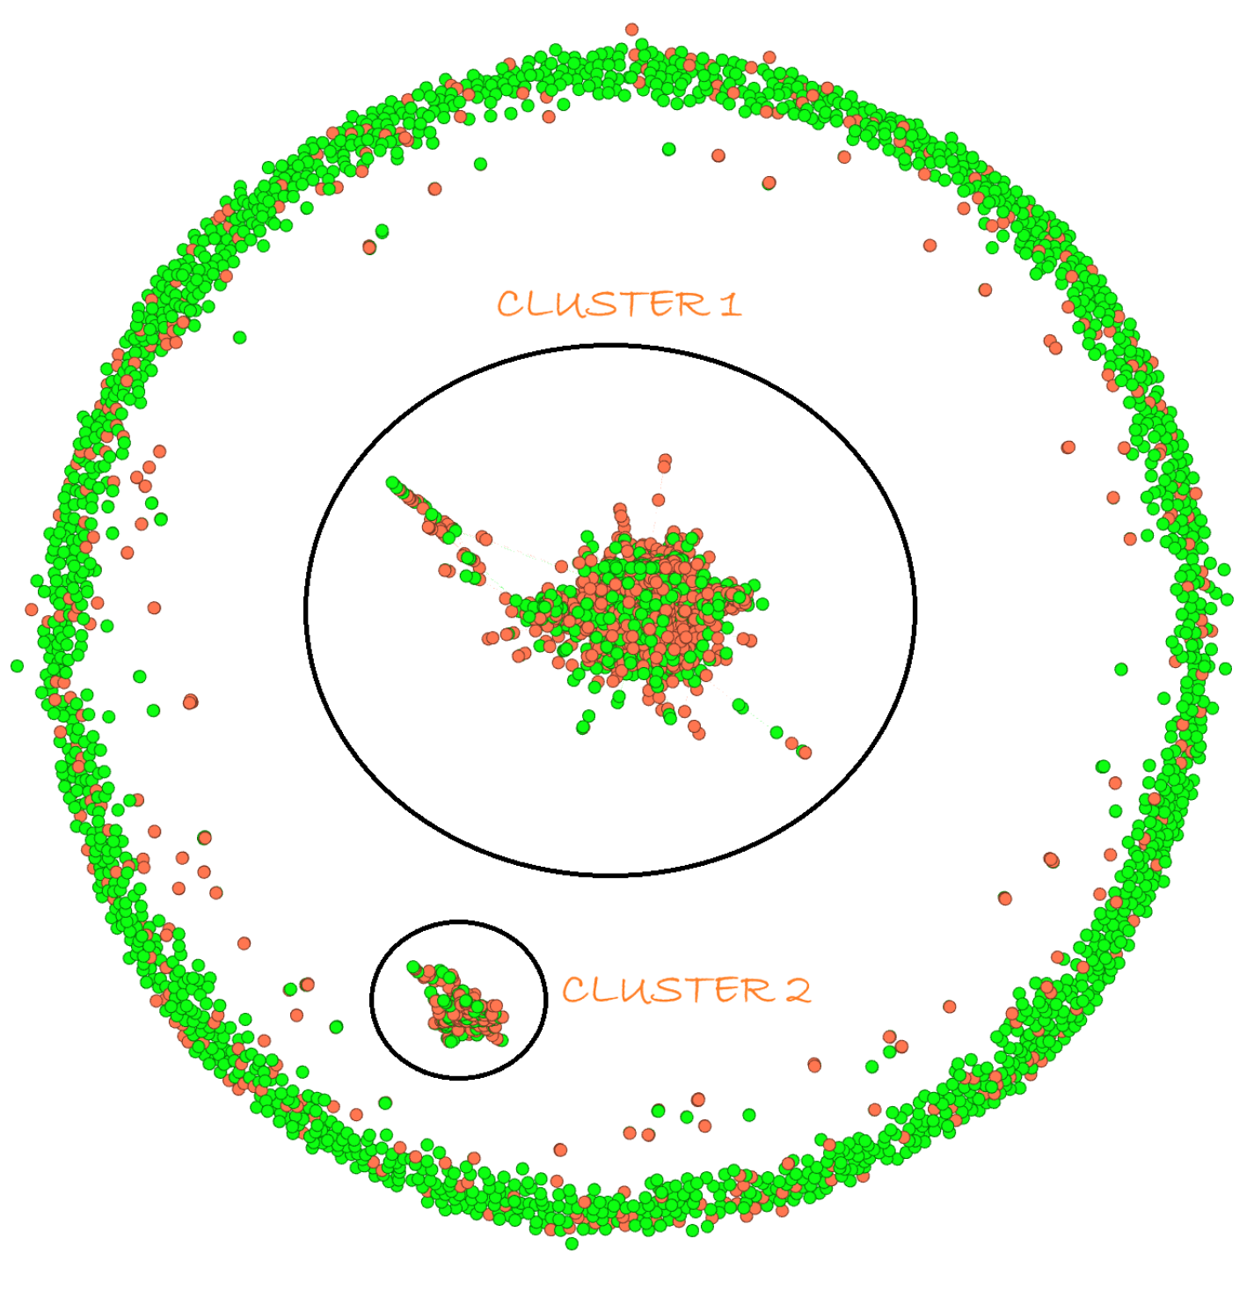
Data Understanding: Social Network Analysis
In order to explore and understand the insight in the networks provided by the dataset, we used a data visualization tool called Gephi to show how the two networks are structured.
The social network presents two connected heterogeneous clusters and a wide group of unconnected safe users.

Slide 12
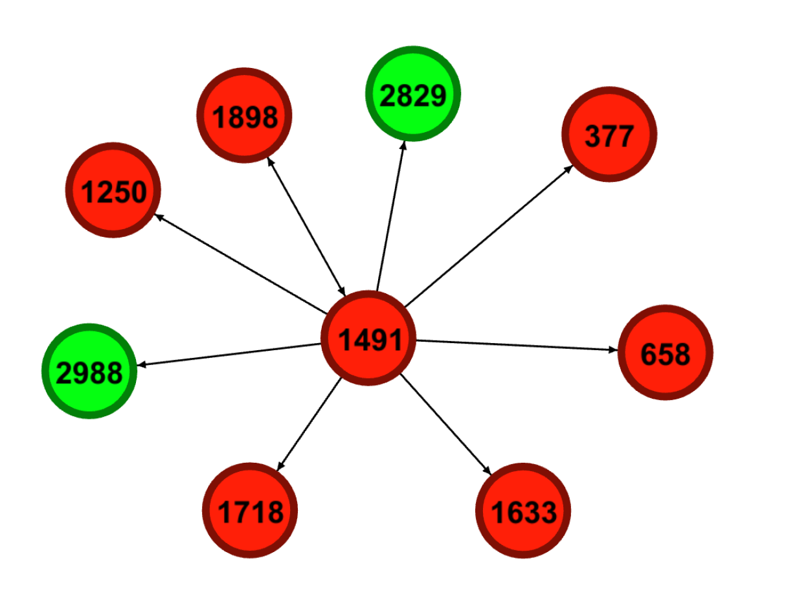
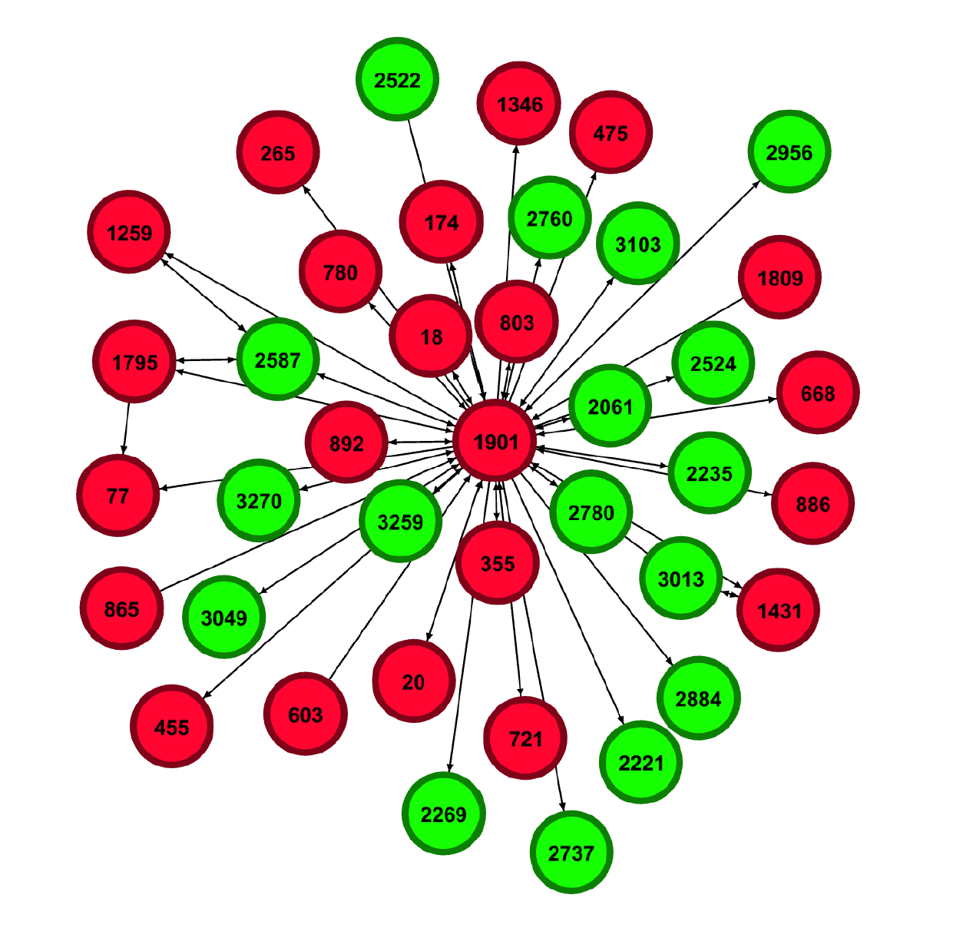
Data Understanding: Social Network Analysis
We can notice observing the following sub-clusters that risky users are usually connected each other.

Slide 13
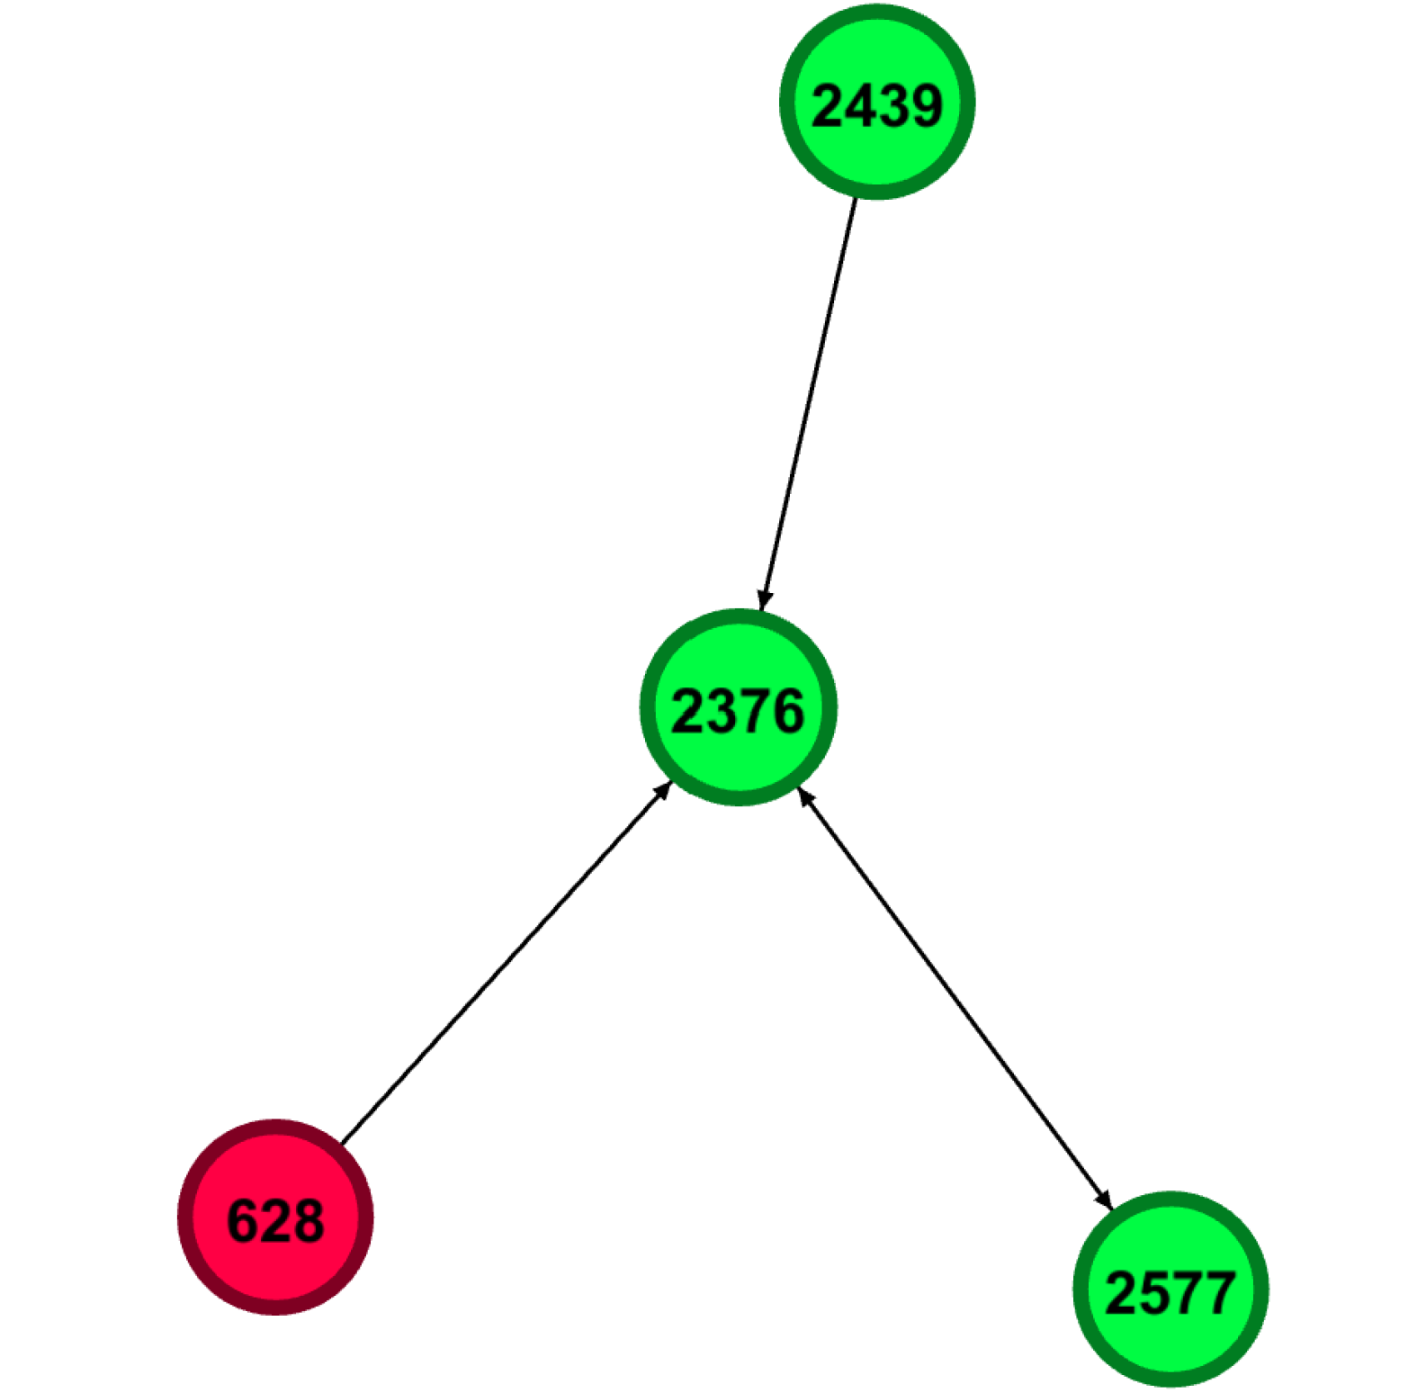
Data Understanding: Social Network Analysis
Finally, an important aspect concerns borderline users. A typical example of such users is represented by journalists who share negative textual contents for informative purposes. These users are considered safe and mainly connected to safe users.
Safe users are mainly connected with safe users as well.

Slide 14
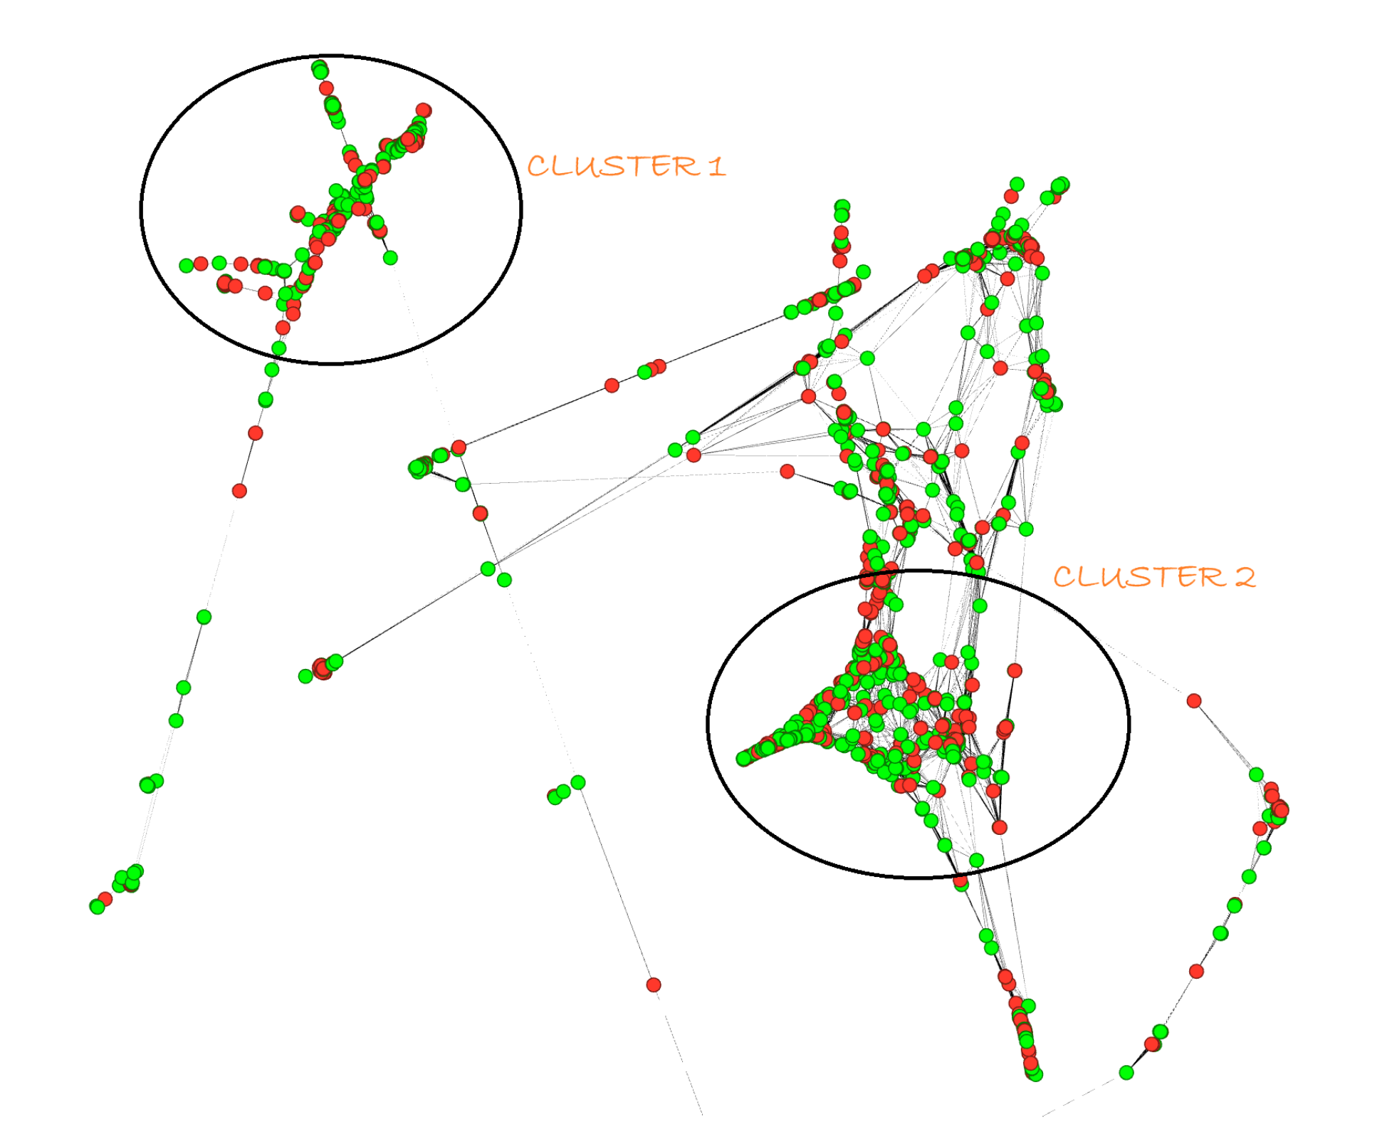
Data Understanding: Spatial Network Analysis
The algorithm used for the visualization of the reduced spatial network takes into account the closeness of the nodes by visually aggregating them when they are more connected.
We can notice that also the spatial network is composed by two main clusters.

Slide 15
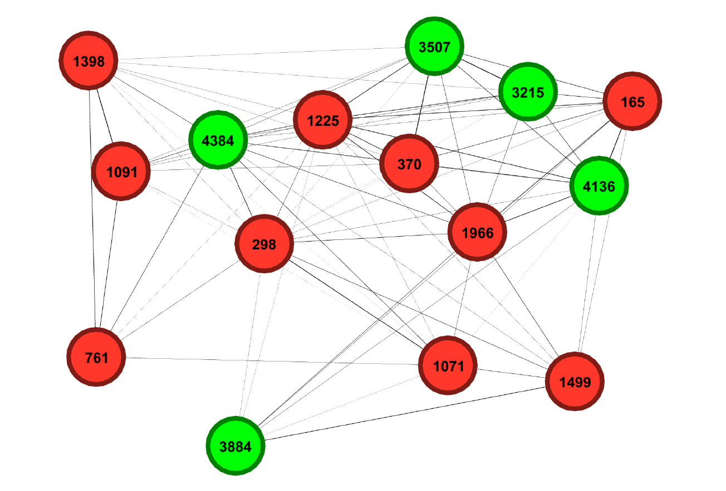
Data Understanding: Spatial Network Analysis
Risky and safe users are more heterogeneously distributed, however can exist clusters of a predominant type due to sociological reasons in certain areas.
Taking into account both social and spatial aspects can reveal the presence of dangerous clusters within a specific geographical area.

Slide 16
Data Preparation
In the CRISP-DM methodology involves collecting, cleaning, transforming and organizing data to ensure it is suitable for analysis and model training.
Need to trasform textual features into numerical values suitable for ML tasks. This is done training 3 word2vec models with embedding dimension of 128, 256 and 512 on all the texts related to training nodes.

Slide 17
Data Preparation
After the word2vec training phase the embedding of each node are computed by summing, node by node, the embedding vector of each word in it.
Additionally we compute the embedding using another algorithm called Twitter4SSE that produce a representation at 768 dimensions using the whole list of words of each node.
After that, the sparse-matrix representation of the networks are computed.
The edges values are set equal to 1 for the social network.
The edges values are read from file for the spatial network.

Slide 18
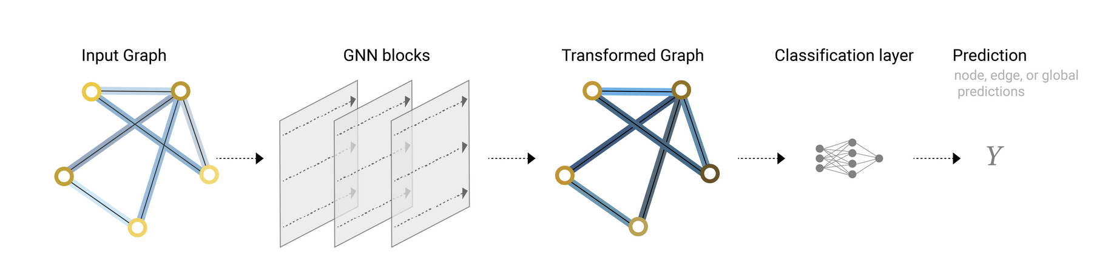
Modelling: An Overview on Graph Convolutional Networks
GNN layers perform a convolution aggregating information about the neighbour of a node.
Adding a layer imply being able to traverse the graph deeply. Too many layers can lead to over-smoothing.

Slide 19
Modelling: The ie-HGCN Model
Interpretable and Efficient Heterogeneous Graph Convolutional Network: model object of our experiments.
Based on transductive learning (entire network as input).
Can deal with heterogeneous nodes by performing the following steps:
Projection in order to bring all heterogeneous neighbour to a share representation.
Aggregation to bring all the information inside the new representation of the node.
Attention to learn which neighbour type contribute the most to the specific task we want to address.

Slide 20
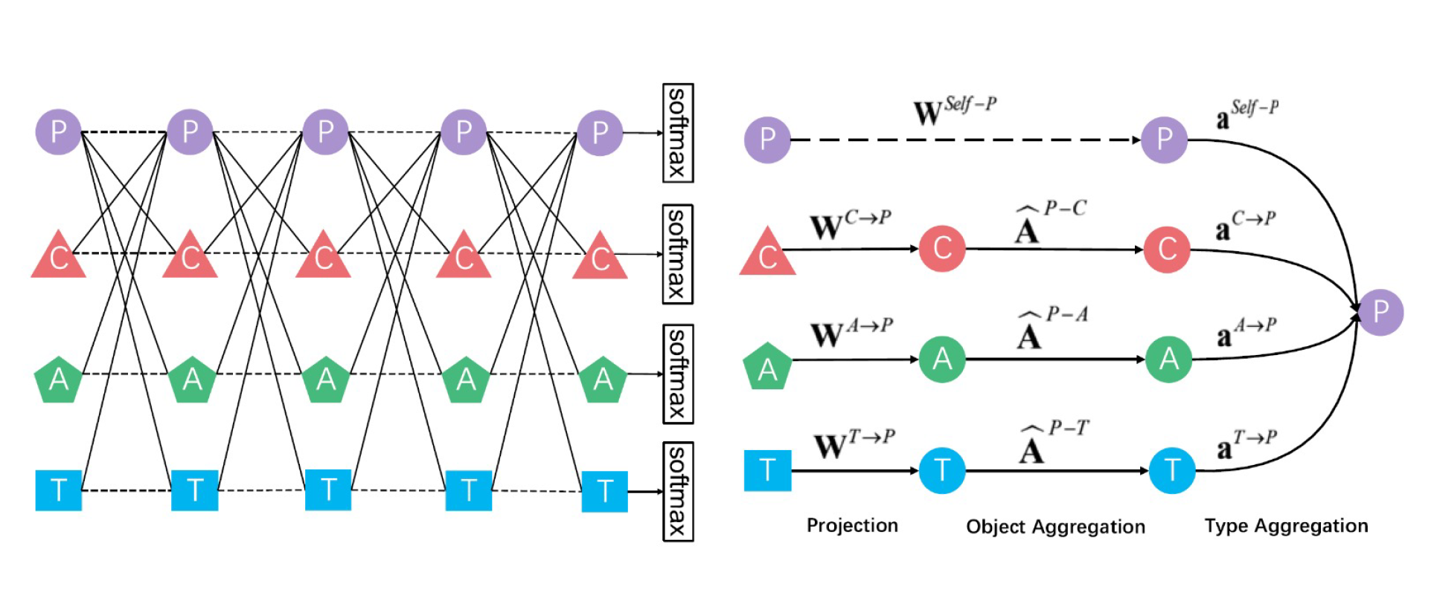
Modelling: The ie-HGCN Model
Example provided by the authors of aggregation of neighbours in a node of type P.

Slide 21
Modelling: The ie-HGCN Model
Model chosen despite being focussed on heterogeneous graph given it efficiency and flexibility.
Trained on 3761 nodes of the training set and tested on the 940 nodes of the test set.
Trained separately on the social network and three different subset of the spatial network built imposing the edges value being greater than a specified threshold value (0.0, 0.49, 0.69).
Trained also on a dummy void network called no-network built imposing the value 0 as edge value. Used as baseline to study how much graph connections participate to enhance predictions.

Slide 22
Results and Evaluations
In bold the best results for a given measure (column).
Significant improvement in recall when the social network is involved.
On the other hand using spatial network does not result in significant improvements given the lack of informativity given by the heterogeneity of such networks. On this kind of network perfomarmaces declines with an embedding dimension of 512.

Slide 23
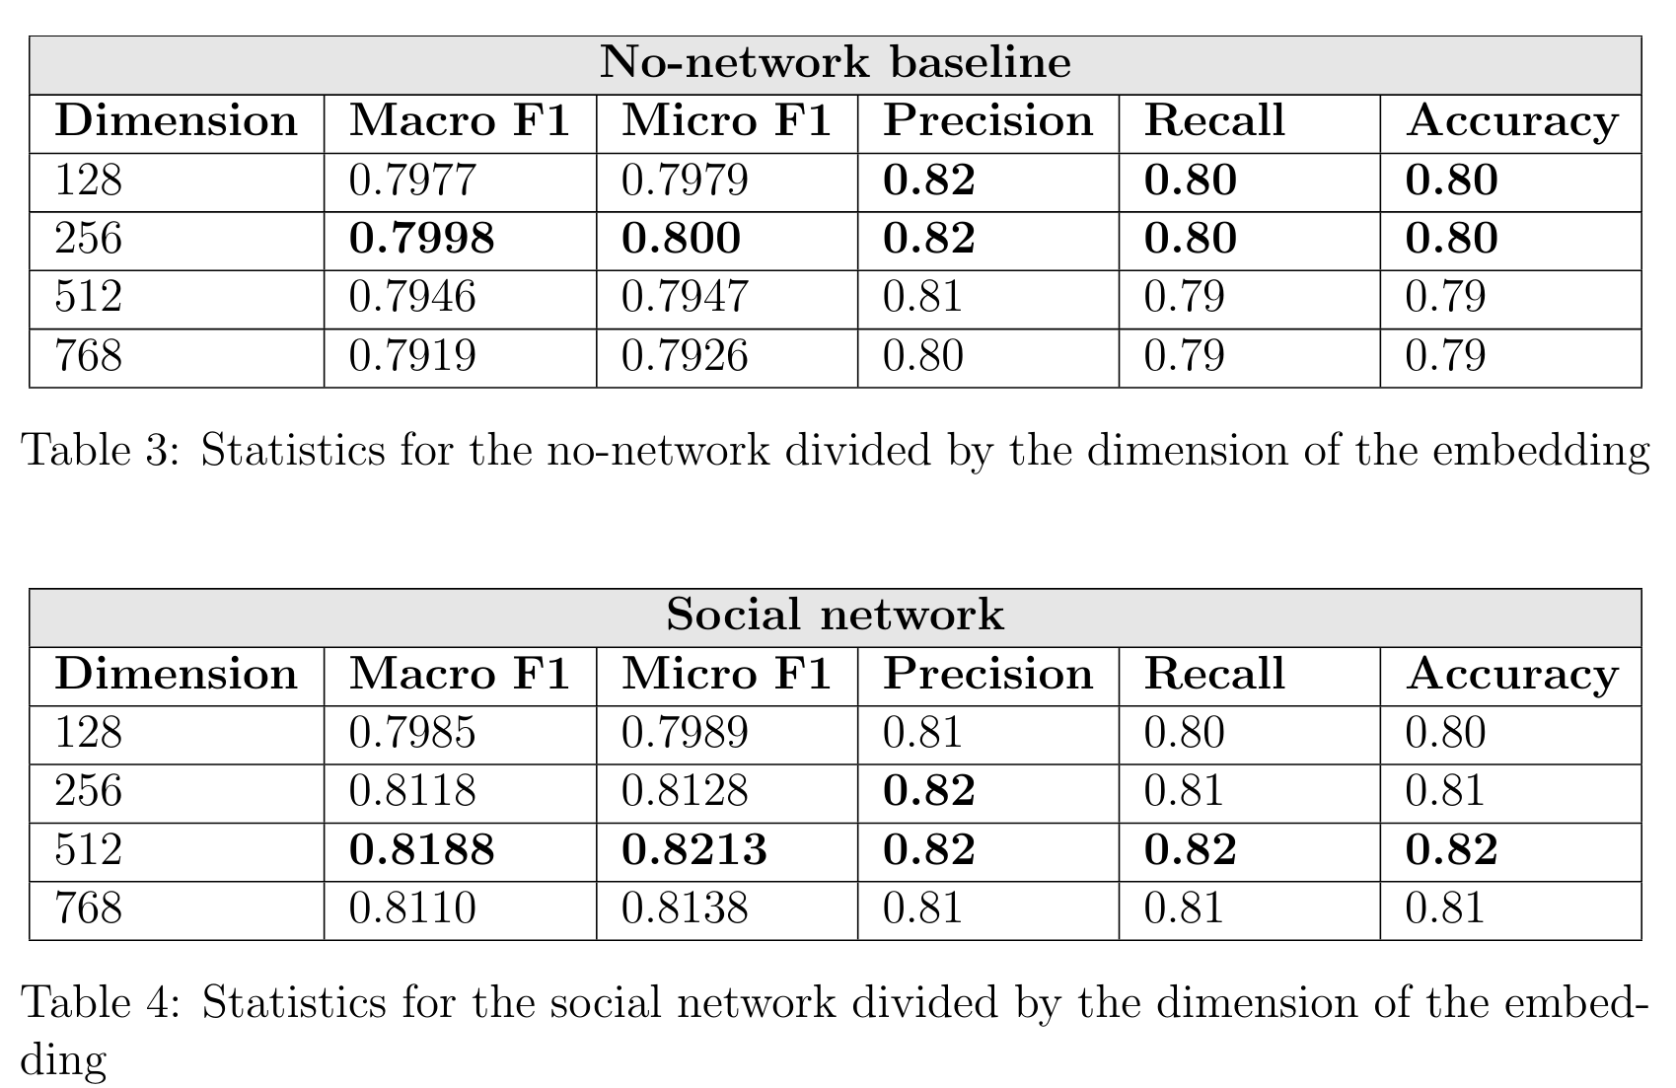
Results and Evaluations

Slide 24
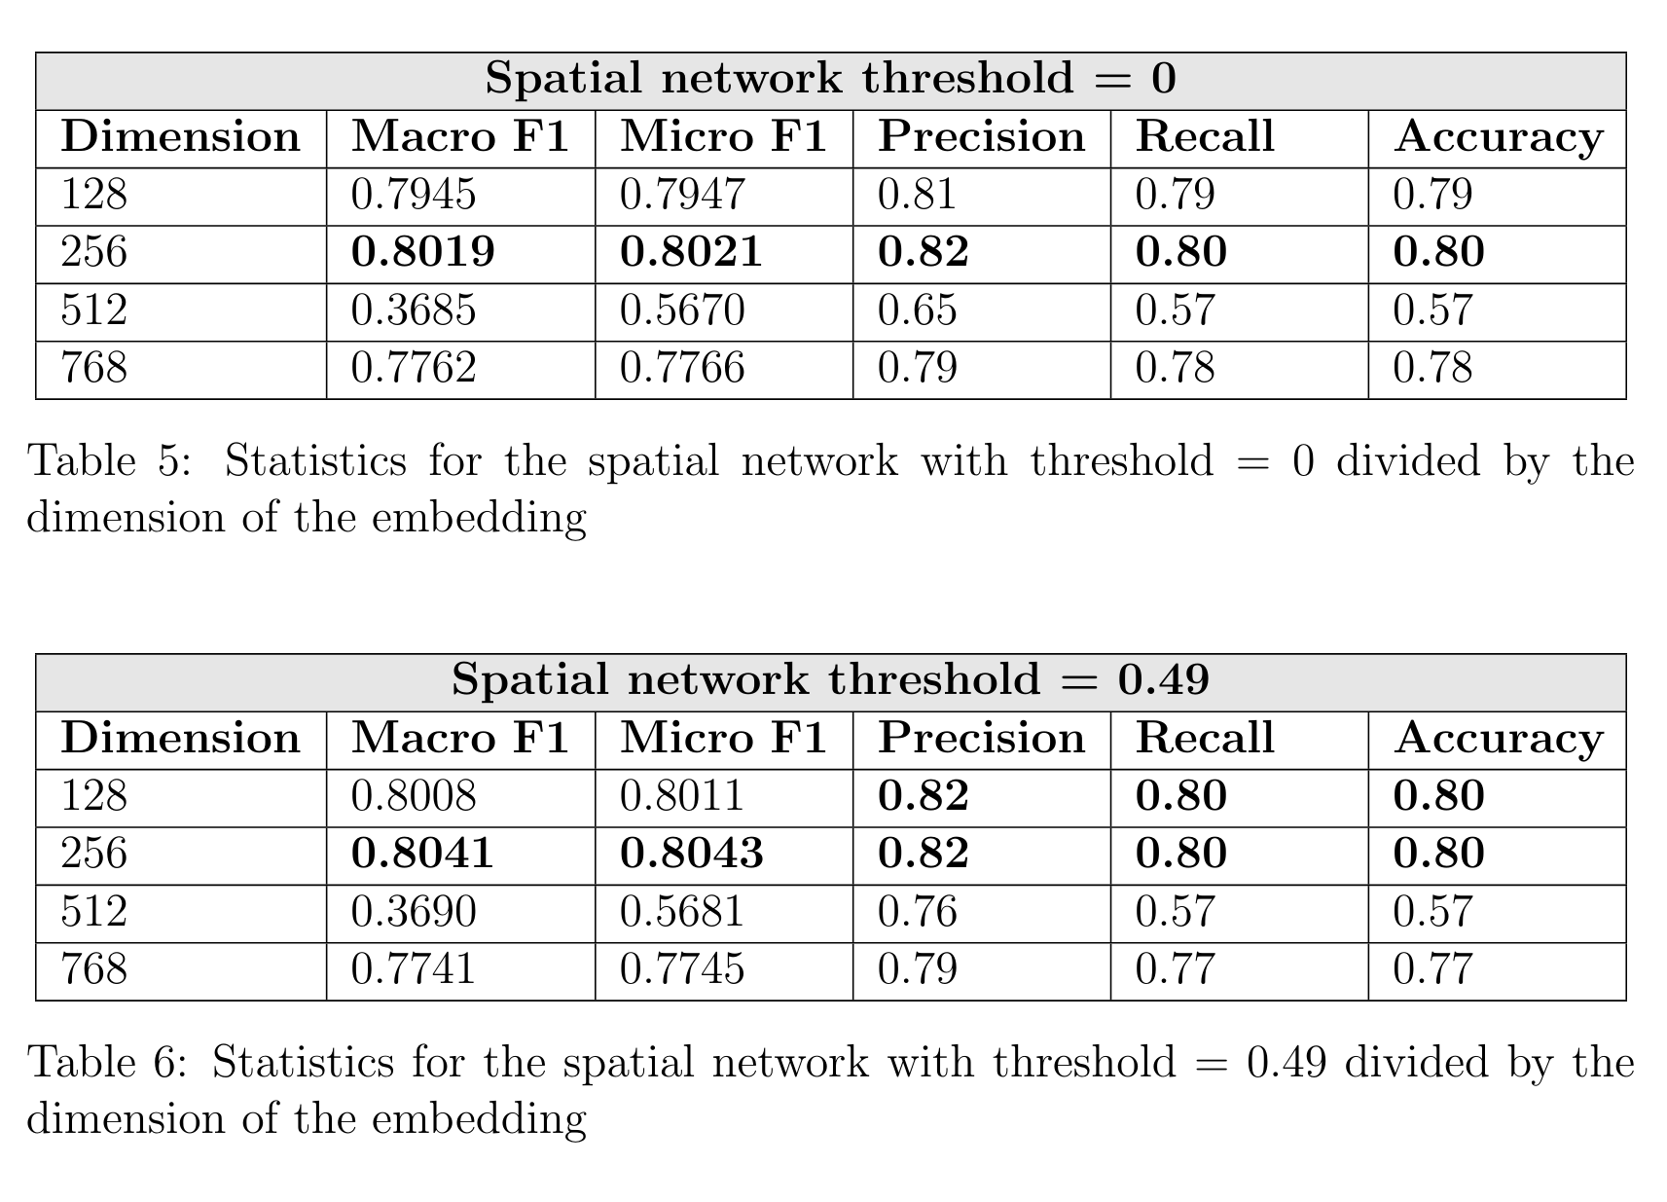
Results and Evaluations

Slide 25
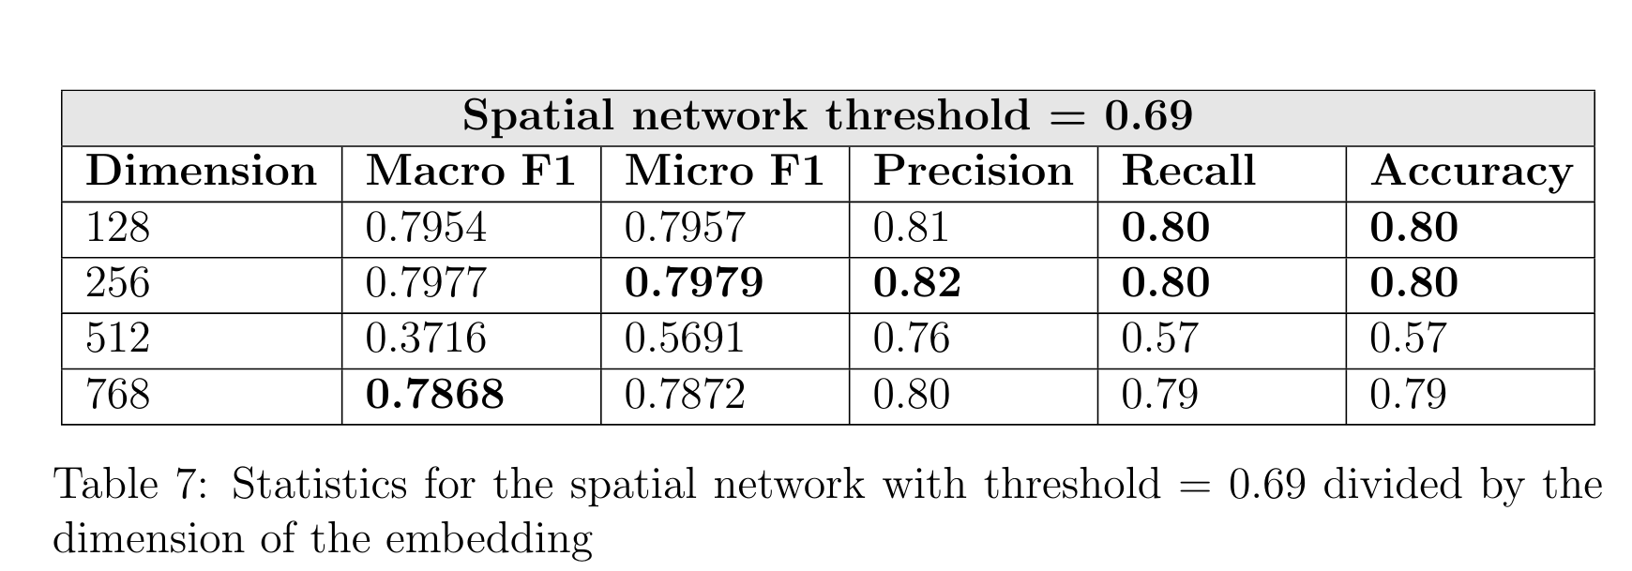
Results and Evaluations

Slide 26
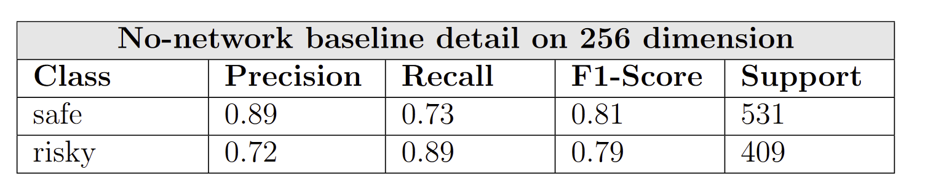
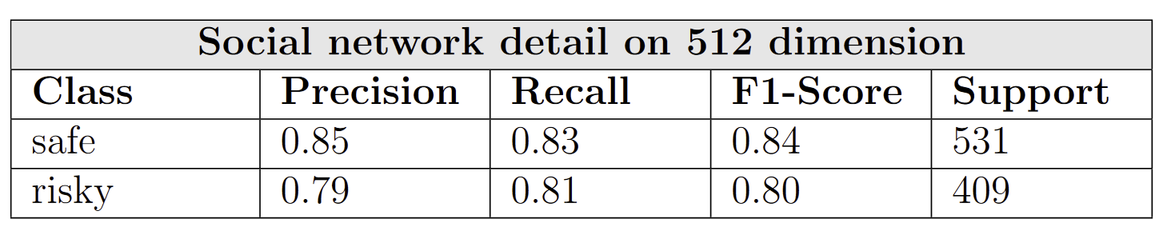
Results and Evaluations
There is a substantial improvement in precision for the risky class, which also impacts the safe class recall.
This implies that, without any information regarding social relationships, many safe users are classified as risky. This phenomenon is likely due to the presence of borderline users who are now more easily recognized.

Slide 27
Conclusion and Future Works
Results on social network are promising confirmin the initial hypoteses. By incorporating social network data, the model gains a more comprehensive understanding of context, sentiment, and user interactions, which enriches its predictive power.
CRISP-DM methodology which emphasizes continuous improvement through iterative analysis. Two main future developments:
Using the ie-HGCN on a properly heterogenous dataset.
Test this dataset on a model capable of dealing with heterogeneous edges.

Slide 28
Thank You
Rocco Caliandro
Antonio Raffaele Iacovazzi

